Slide 1
Chapter 7 Syntax-Directed Compilation (AST & Target Code)

Slide 2
The Choices of Program Execution
The choices are:
1) little preprocessing that generates the abstract syntax tree (AST) or the intermediate representation (IR) such as Java byte code, followed by execution of an interpreter, and
2) much preprocessing that generates target (assembly) code, followed by execution by CPU.

Slide 3
Practical Implementation Concerns
OK, now you know YACC.
An obvious choice – you can write code in the production actions to generate x86 code and the code takes into account of x86 architecture.
Is it good?

Slide 4
Of course NOT
Yes, some guys in earlier time may choose that
but he/she should learn the painful experience when his/her boss told him to port the compiler to ARM, MIPS….
It is common to add an additional layer of abstraction to increase maintainability, extensibility, and scalability. (A typical software engineering problem)
This is when your straightforward/brute-force approach seldom works in practice.

Slide 5
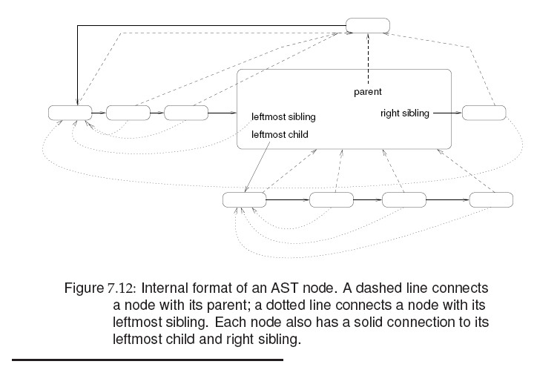

Slide 6
Interpretation
The simplest way to have the actions expressed by the source program performed is to process the abstract syntax tree (AST) using an interpreter.
An interpreter considers the nodes of the AST in the correct order and performs the action prescribed for those nodes by the semantics of the language.

Slide 7

NOTE
do not mix orange and apple, the interpreter is not the interpreter like java-script interpreter or basic interpreter. It is a program which traverse the AST and generate code. So, CPUs with different instruction set must have different interpreter to traverse the AST)
An interpreter is like a pre/in/post order traversal program in data structure.

Slide 8
Interpretation
Interpreters come in two forms:
recursive and iterative.
A recursive interpreter works directly on AST and requires less preprocessing than an iterative interpreter, which works on threaded AST.

Slide 9
Recursive Interpretation
A recursive interpreter has an interpreting routine for each node type in the AST.
Such an interpreting routine calls other similar routines, depending on its children.

Slide 10
Let’s give a simple example first
AST for (2*((3*4)+9)) result 42 P:parent
D:descedent
P
left
*
right
operator
D
P
2
+
P
D
*
9
D
D
3
4

Slide 11
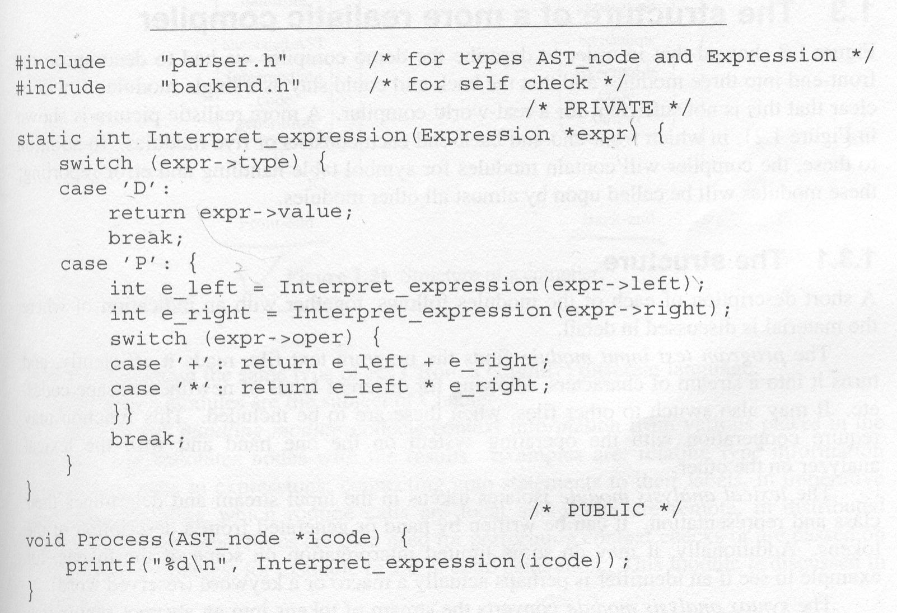
Recursive Interpretation (Cont.)

Slide 12
Iterative Interpretation
The structure of an iterative interpreter looks much closer to that of a CPU than a recursive interpreter.
It consists of a flat loop over a case statement which contains a code segment for each node type.
It requires a threaded AST, and maintains an active-node pointer, which points to the node to be interpreted.

Slide 13
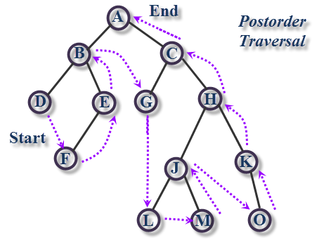
Threaded AST with Post-Order

Slide 14
Iterative Interpretation (Cont.)
The iterative interpreter repeatedly runs the code segment for the node pointed at by the active-node pointer;
this code sets the active-node pointer to another node, its successor, thus leading the interpreter to that node.

Slide 15
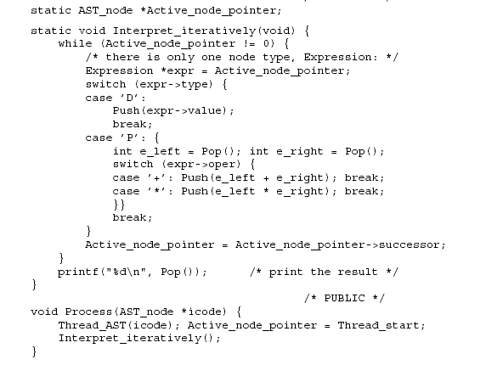
Iterative Interpretation (Cont.)

Slide 16
NOTE
Iterative interpreter uses a stack
What is that?
Recursive use system stack to save the states for you. So, to write a program as loop you need to use stack.

Slide 17
Simple Code Generation
In simple code generation, a fixed translation to the target code is chosen for each node type.
During code generation, the nodes in the AST are replaced by their translations.

Slide 18
Simple Code Generation (Cont.)
Simple code generation requires local decisions only.
With respect to machine types, it is particularly suitable for two similar machines: 1) pure stack machine and
2) pure register machine.

Slide 19
Simple Code Generation (Cont.)
A pure stack machine uses a stack to store and manipulate values; it has no registers.
It has two types of instructions:
1) Instructions that move or copy values between the top of the stack and else where, and
2) Instructions that do operations on the top element or elements of the stack.

Slide 20
Simple Code Generation (Cont.)
The stack machine has two important data administration pointers:
1) the stack pointer (SP) pointing to the top of the stack.
2) the base pointer (BP) pointing to the beginning of the region on the stack where the local variables are stored.

Slide 21
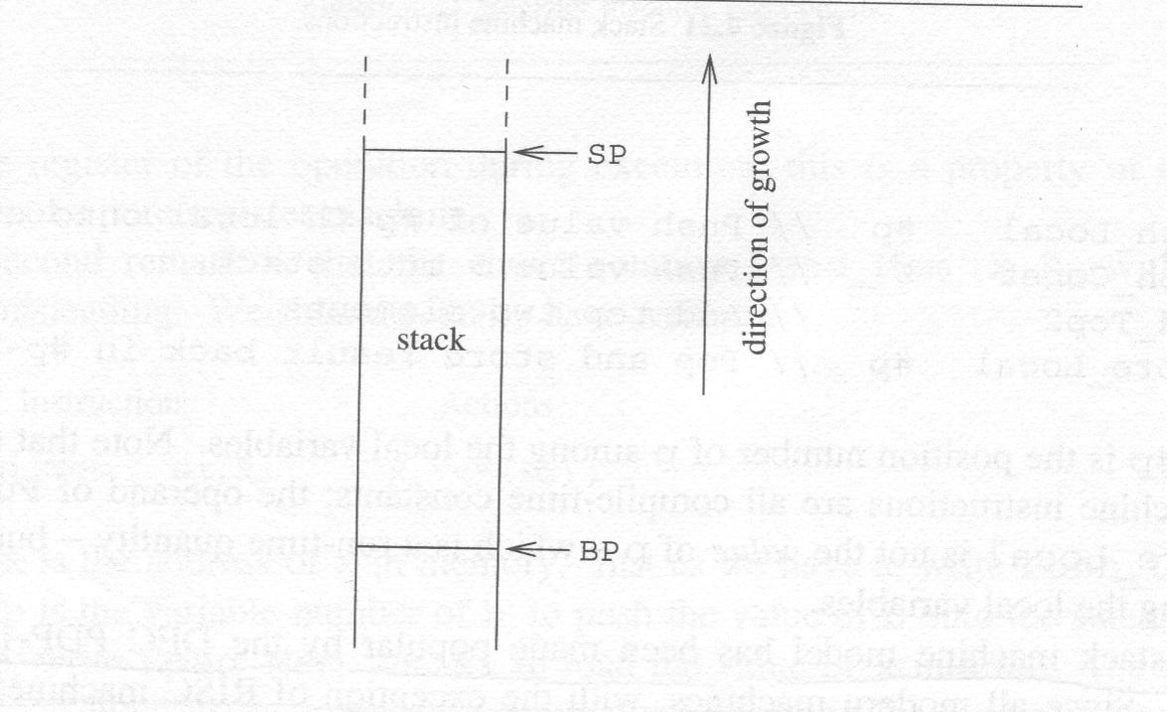
Simple Code Generation (Cont.)

Slide 22
Simple Code Generation (Cont.)
We assume a very simple stack machine
in which:
1) stack entries are of type integer
2) its instructions are summarized next.

Slide 23
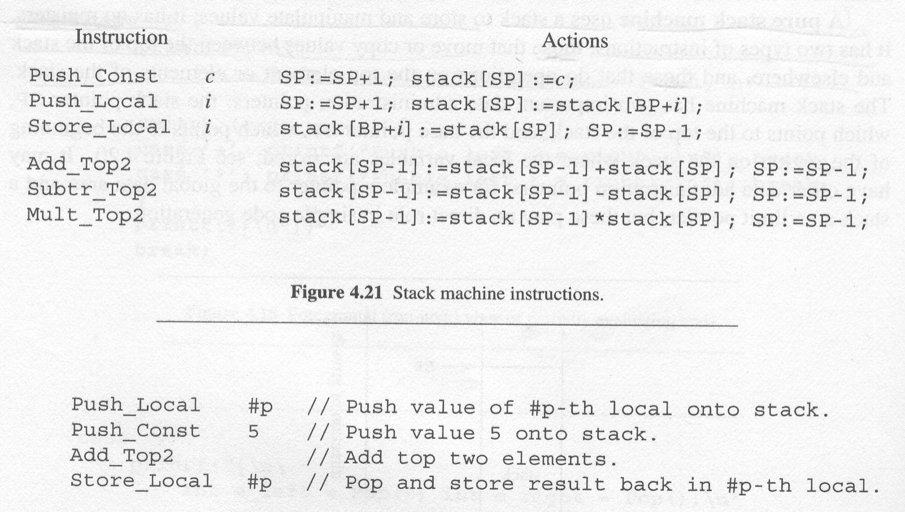
Simple Code Generation (Cont.)

Slide 24
Why stack machine?
Stack machine instruction are shorter
Dense machine code was very valuable in the 1960s, when main memory was very expensive and very limited even on mainframes. It became important again on the initially-tiny memories of minicomputers and then microprocessors. Density remains important today, for smartphone applications and for Java applications downloaded into browsers over slow Internet connections.
Compiler is simpler and code generation is much easier to build.

Slide 25
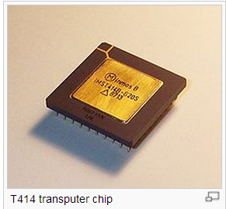
Practical Stack Machine?
The transputer was a pioneering microprocessorarchitecture of the 1980s, featuring integrated memory andserial communication links, intended for parallel computing.

Slide 26
Simple Code Generation (Cont.)
Suppose p is a local variable; then we have
p := p + 5
the code is:

Slide 27
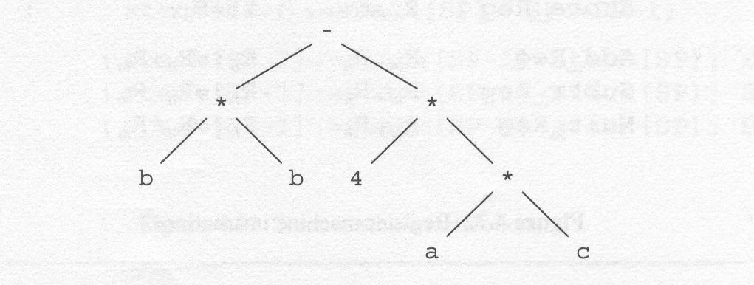
Simple Code Generation (Cont.)
Another example:
The expression b * b - 4 * (a * c)
its AST is:

Slide 28
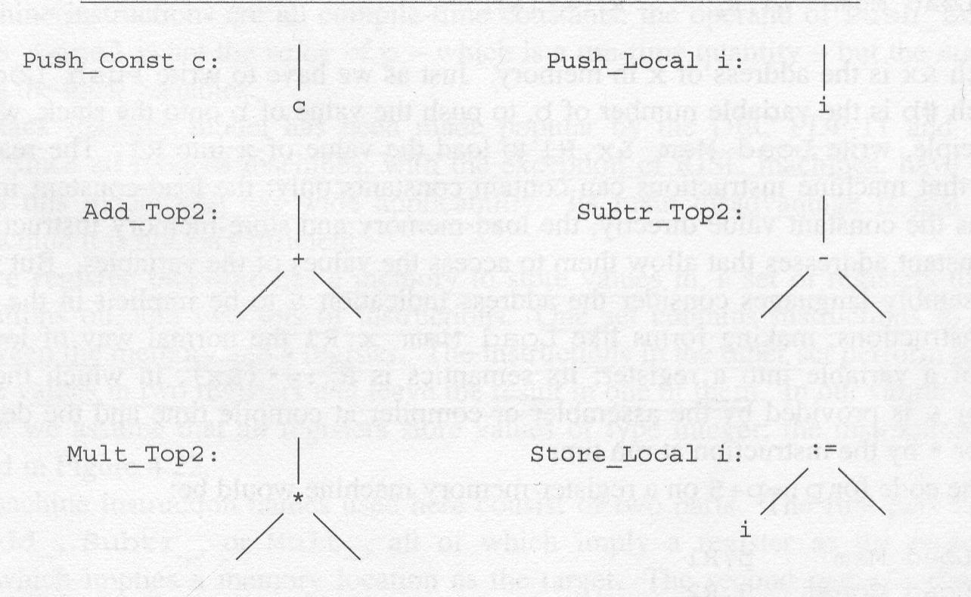
Simple Code Generation (Cont.)
Stack machine instructions for the AST:

Slide 29
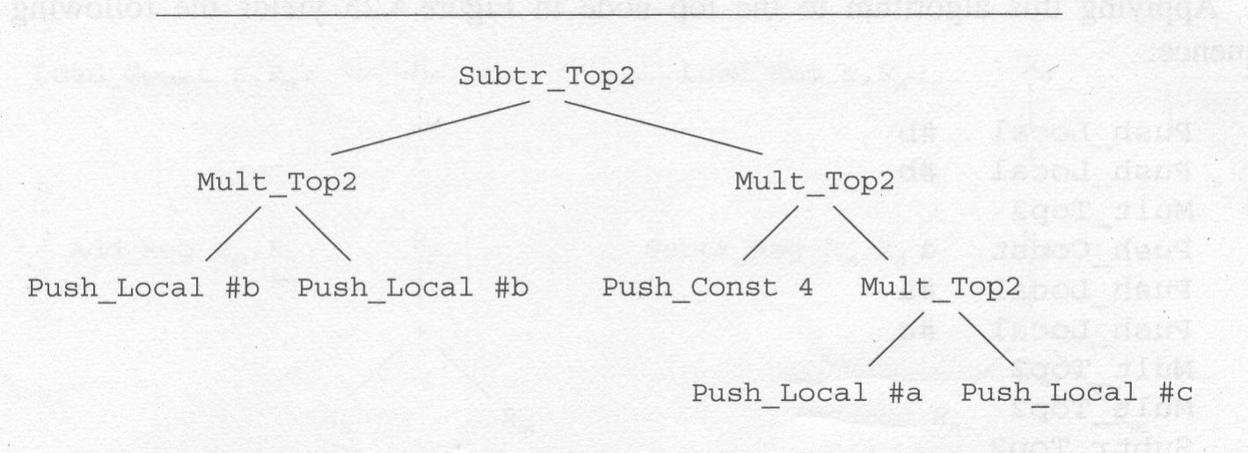
Simple Code Generation (Cont.)
Instructions for b * b – 4 * (a * c)

Slide 30
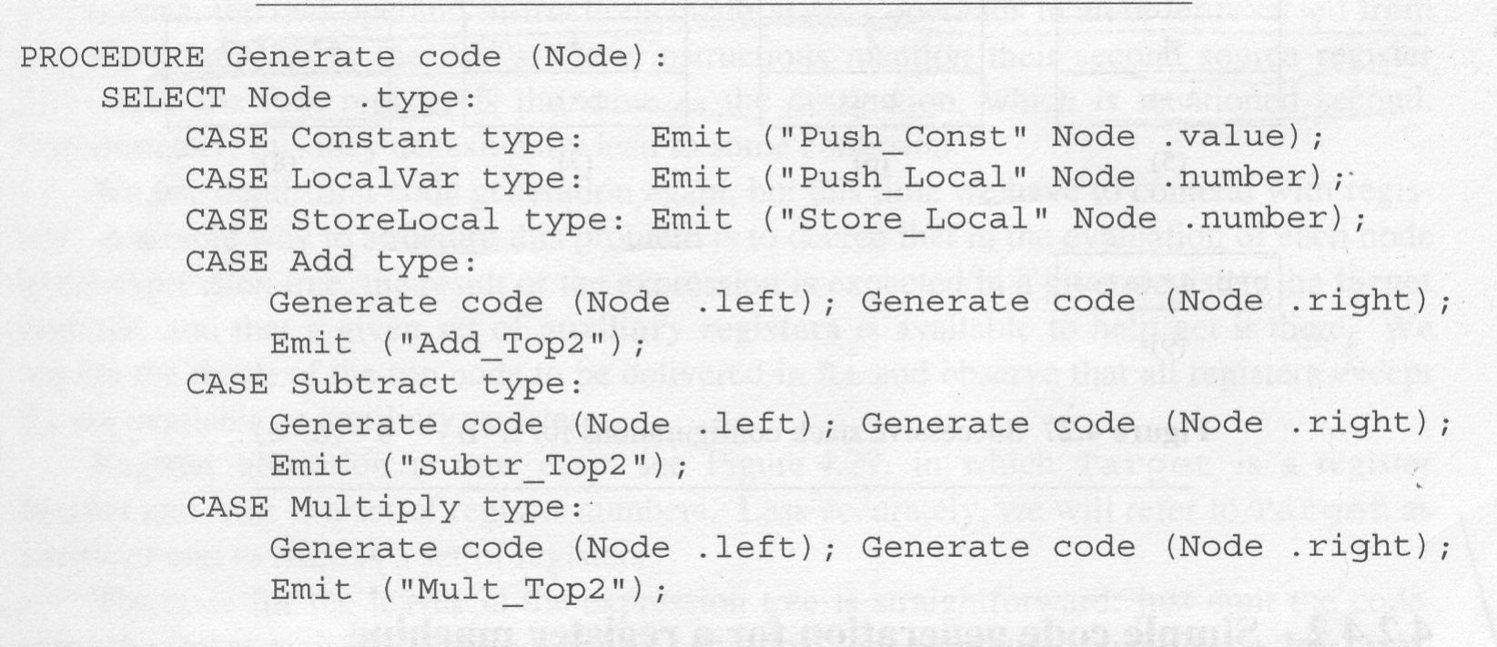
Simple Code Generation (Cont.)
Depth-first code generation algorithm for a stack machine

Slide 31
Simple Code Generation (Cont.)
Applying this algorithm to the top node yields the following code sequence:
Push_Local #b
Push_Local #b
Mult_Top2
Push_Const 4
Push_Local #a
Push_Local #c
Mult_Top2
Mult_Top2
Subtr_Top2

Slide 32
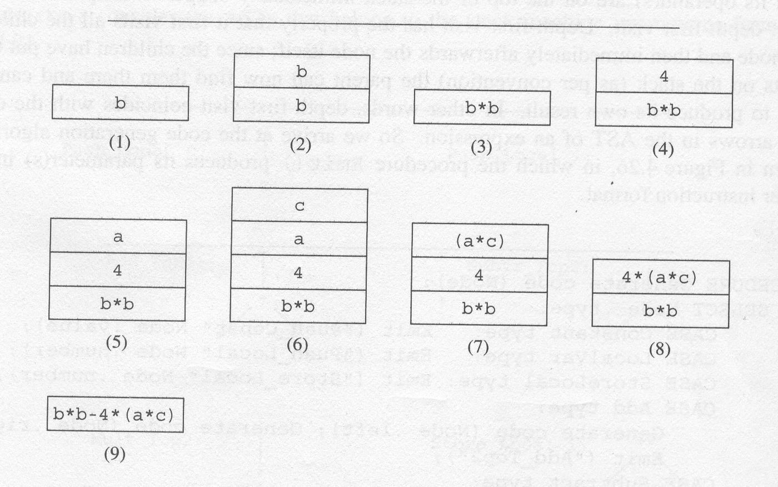
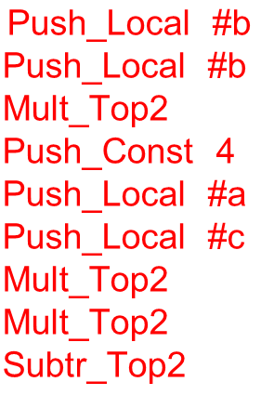
Stack configuration for b*b-4*(a * c)

Slide 33

NOTES
OK, you may never encounter stack machine in your whole life.
The points of the above are to tell you that if you have a stack machine (simpler instruction set), its architecture and AST’s post-order traversal are really 麻吉
They can sing a simplest code generation rhythm together

Slide 34
Simple Code Generation (Cont.)
A pure register machine stores values in a set of registers to perform operations, and two sets of instructions below:
1) Instructions that copy values between the memory and a register.
2) Instructions that perform operations on the values in two registers and leave the result in one of them.

Slide 35
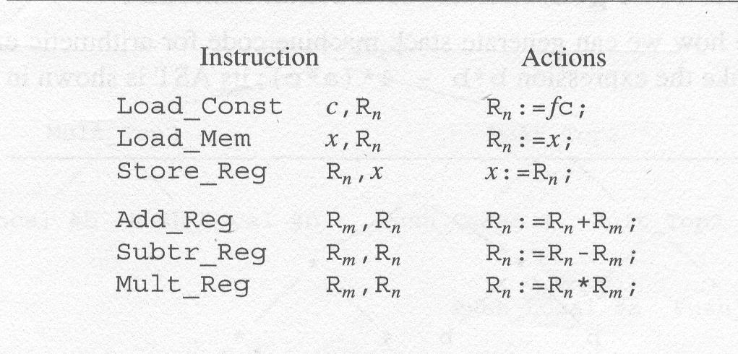
Simple Code Generation (Cont.)

Slide 36
Simple Code Generation (Cont.)
The code for p := p + 5 on a register machine would be:
Load_Mem p, R1
Load_Const 5, R2
Add_Reg R2, R1
Store_Reg R1, p

Slide 37
Simple Code Generation (Cont.)
An example expression: b*b - 4*(a*c)

Slide 38
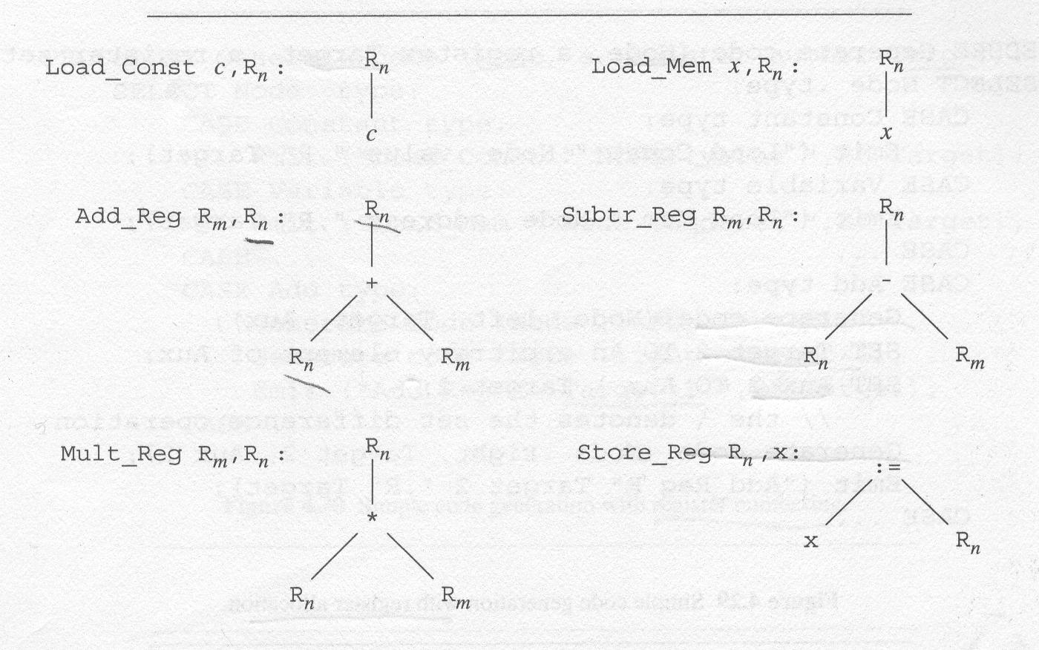
Simple Code Generation (Cont.)
Register machine instructions for AST

Slide 39
















Simple Code Generation (Cont.)
ARM instructions for AST:
c
x
+
: =
*
x

Slide 40
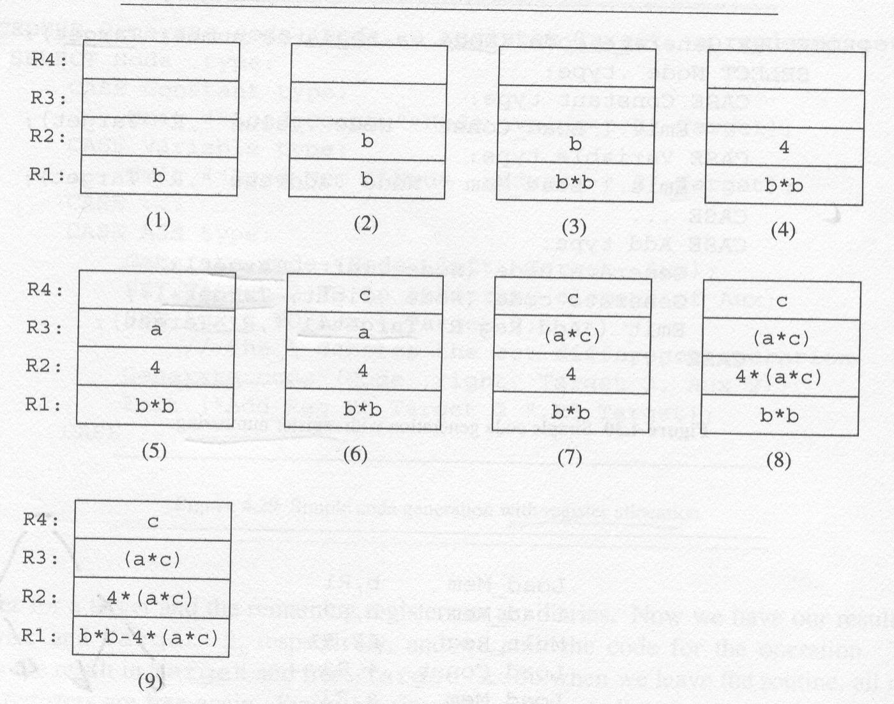
Can we do it once by hand?

Slide 41
Simple Code Generation (Cont.)
We use depth-first code generation again, but this time we use registers.
The result of the expression is expected in a given register (the target register), and a given set of auxiliary registers is available to help get there.

Slide 42
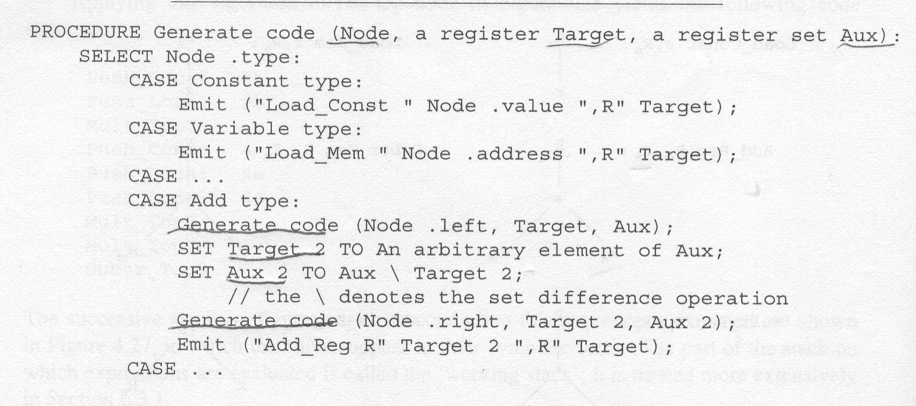
Simple Code Generation (Cont.)
Target is a register number

Slide 43
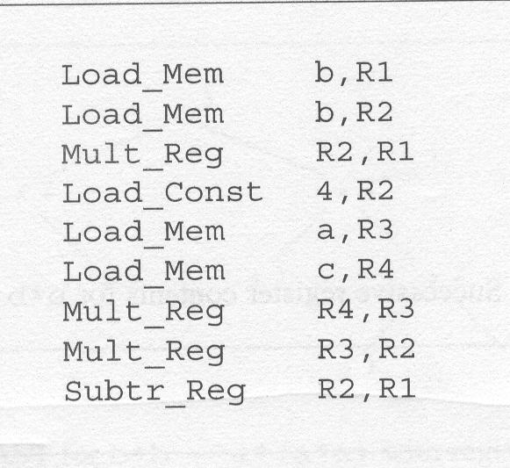
Simple Code Generation (Cont.)
Register machine code for the expression b*b-4*(a*c)

Slide 44
Simple Code Generation (Cont.)
Successive register contents for:
b*b-4*(a*c)

Slide 45
Simple Code Generation- weighted register allocation
It is disappointing to see that:
4 registers are required for the expression where 3 would do.
The reason is that one register gets tied up holding the value 4 while the sub-tree a*c is being computed.
If we had treated the right sub-tree (a*c) first, rather than 4, 3 registers would have sufficed.

Slide 46
Simple Code Generation- weighted register allocation (Cont.)
We will call the number of registers required by a node its weight.
Since the weight of each leaf is known and the weight of a node can be computed from the weights of its children,
the weight of a sub-tree can be determined simply by a pre-scan.

Slide 47
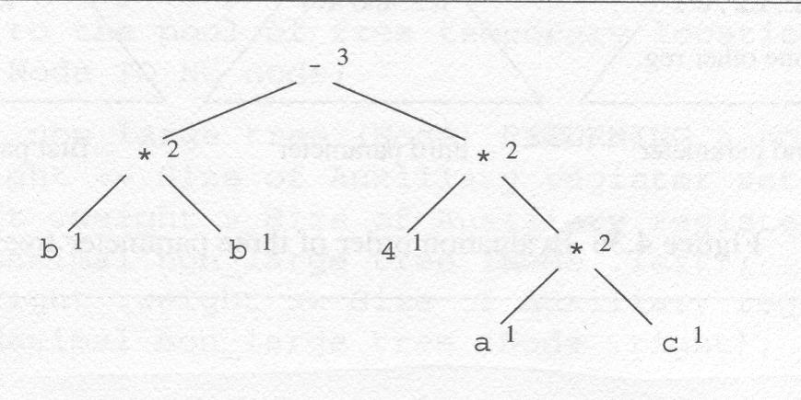
Simple Code Generation- weighted register allocation (Cont.)
An example expression b*b-4*(a*c)

Slide 48
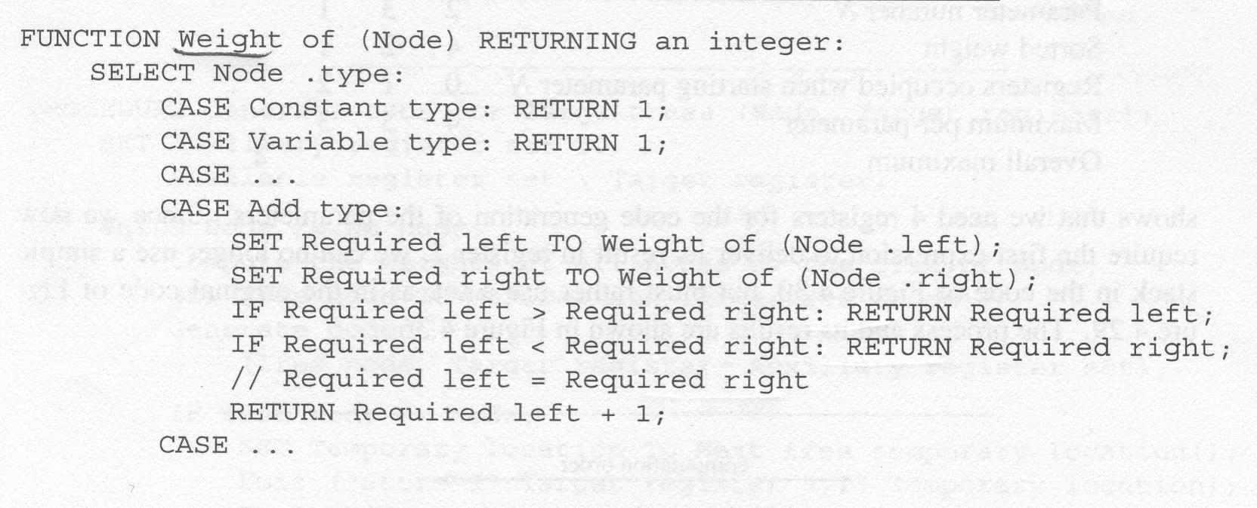
Simple Code Generation- weighted register allocation (Cont.)

Slide 49
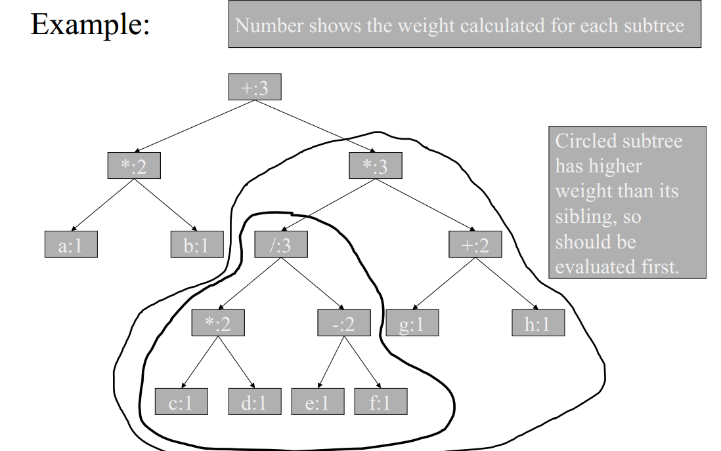

Slide 50
Code Generation
Compilation produces target code from the AST through a process called:
Code Generation.
The basis of it is the systematic replacement of nodes and sub-trees of the AST by target code segments.
The replacement process is called:
Tree Rewriting.

Slide 51
Code Generation (Cont.)
As a demonstration, suppose we have constructed the AST for the expression
a := (b [4 * c + d] * 2) + 9;
in which a, c, and d are integer variables and b is a byte array in memory.

Slide 52
Code Generation (Cont.)
The compiler has decided that:
1) the variables a, c, and d are in the registers Ra, Rc, and Rd, and that
2) the array indexing operator [ for byte arrays has been expanded into:
an addition and
a memory access “mem”.

Slide 53
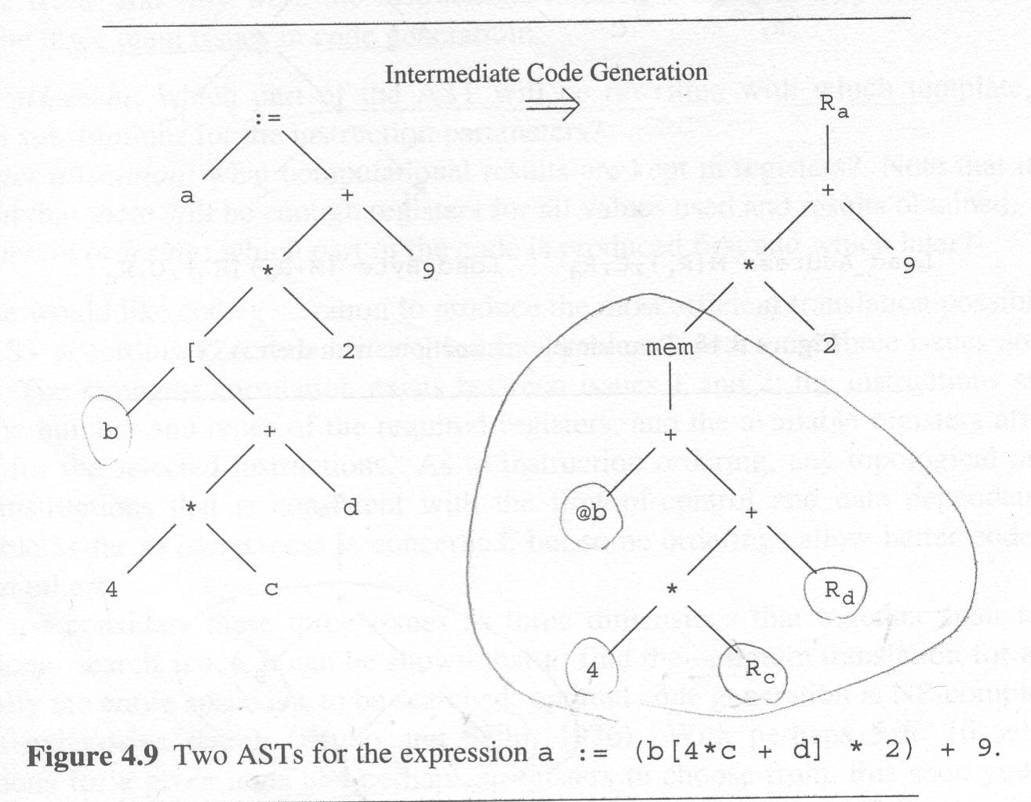
Code Generation (Cont.)

Slide 54
Code Generation (Cont.)
Let’s get more help from the machine instruction sets. We have two machine instructions:
Load_Addr M[Ri], C, Rd
loads the address of the Ri-th element of the array at M into Rd,
where the size of element of M is C bytes.
Load_Byte (M+Ro) [Ri], C, Rd
loads the byte content of the Ri-th element of the array at M plus offset Ro into Rd.

Slide 55
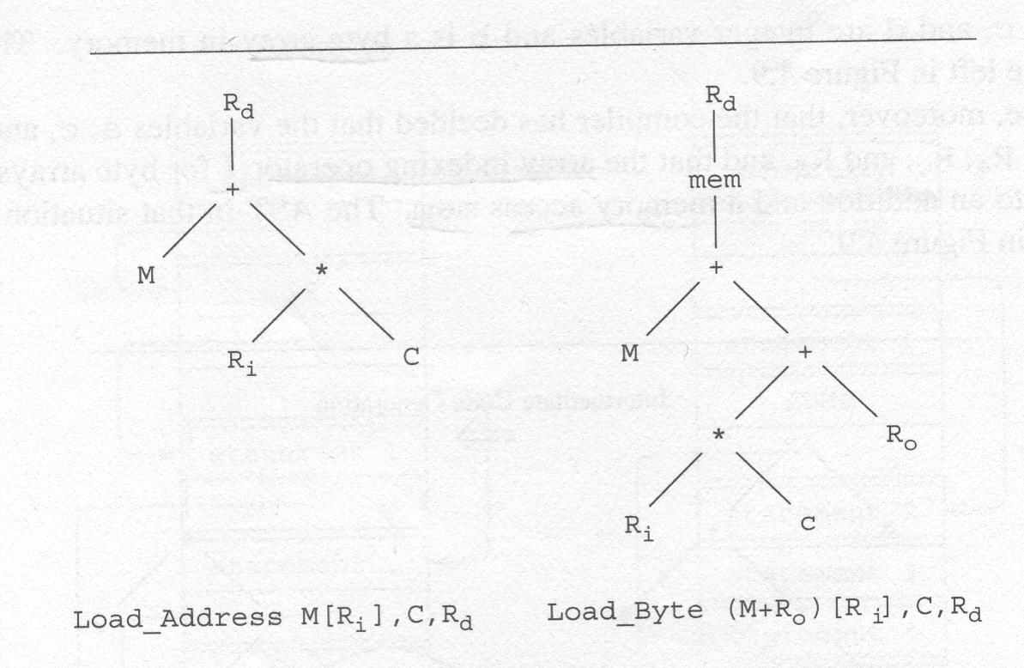
Code Generation (Cont.)

Slide 56
Code Generation (Cont.)
We first replace the bottom right of AST by:
Load_Byte (b+Rd) [Rc], 4, Rt
by equating M with b, Ro with Rd,
Ri with Rc, C with 4, and
using a temporary register Rt
as the result register.

Slide 57
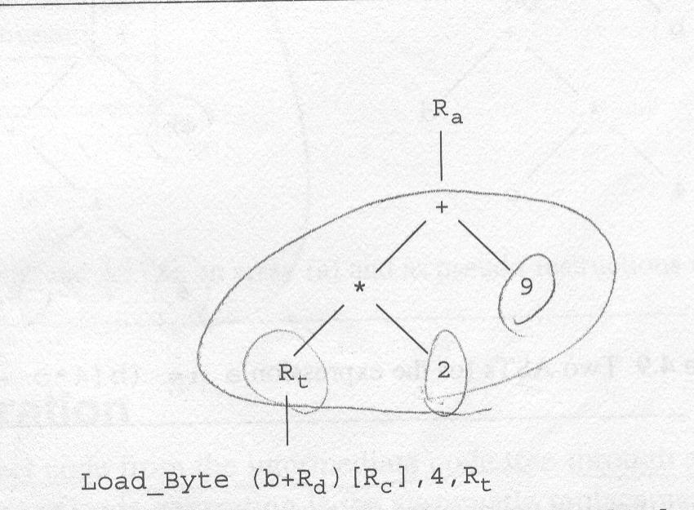
Code Generation (Cont.)

Slide 58
Code Generation (Cont.)
Next we replace the top by:
Load_Addr 9[Rt], 2, Ra
by equating M with 9, Ri with Rt, C with 2,
and using the register Ra which holds “a”
as the result register.

Slide 59
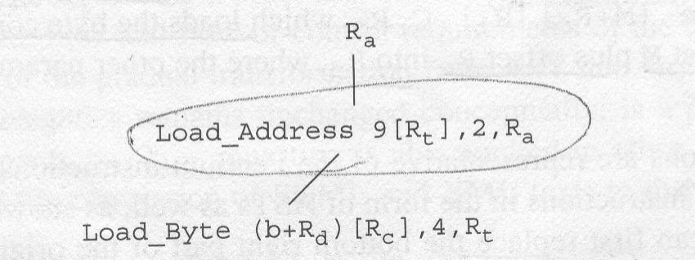
Code Generation (Cont.)

Slide 60
Code Generation (Cont.)
Note that the fixed address of the array in the “Load_Addr” instruction is specified explicitly as 9.
This yields the target code:
Load_Byte (b+rd) [Rc], 4, Rt
Load_Addr 9[Rt], 2, Ra

Slide 61
Bottom-up rewriting system (BURS) code generation
The figure next shows a small set of instructions, which is representative of modern machines, large enough to show the principles involved and small enough to make explanation.
For each instruction we show:
1) an identifying number
2) the AST it represents,
3) the instruction name,
4) its semantics, and
5) its cost of execution.

Slide 62
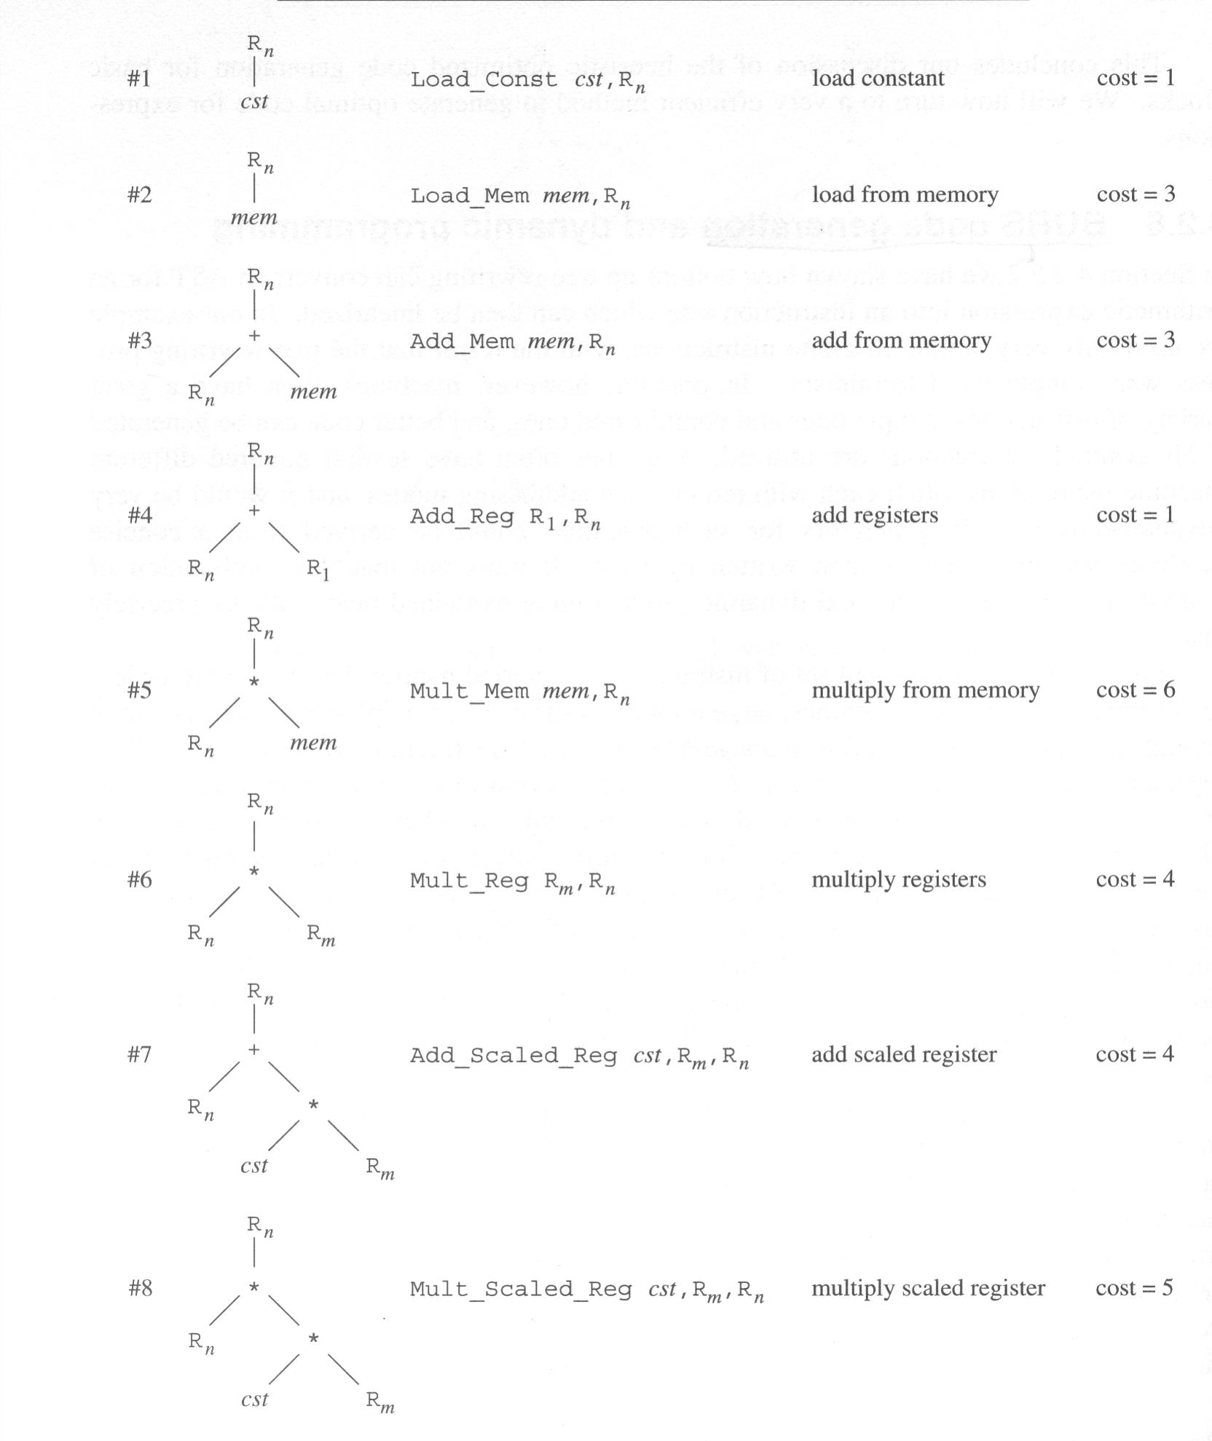

Slide 63
NOTES
It is common to provide additional instruction sets for similar purposes.
Since we have alternatives to choose from, it creates a problem of optimization.

Slide 64
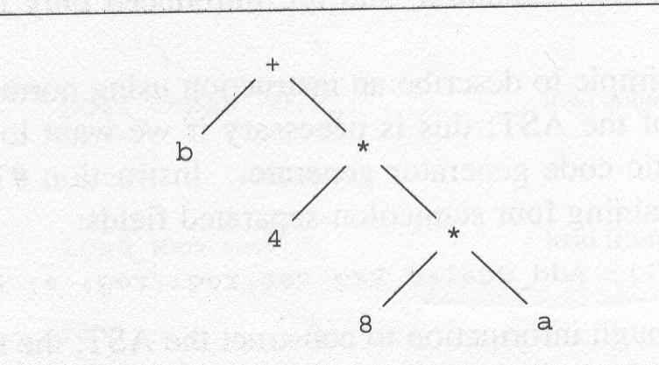
Bottom-up rewriting system (BURS) code generation (Cont.)
The AST for which we are going to generate code is given below.

Slide 65
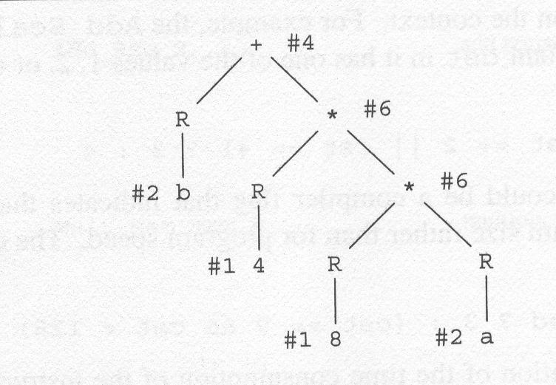
Bottom-up rewriting system (BURS) code generation (Cont.)
Naïve bottom-up rewrite of the AST:

Slide 66
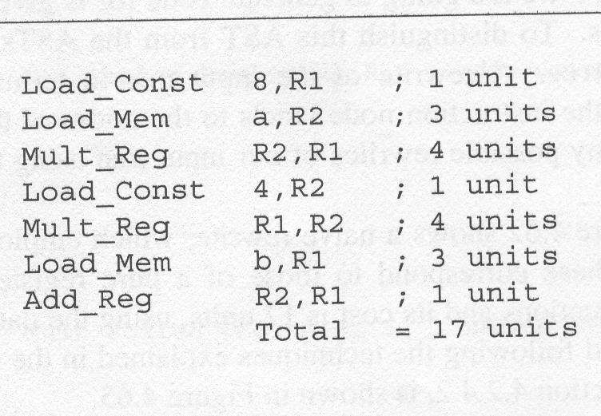
Bottom-up rewriting system (BURS) code generation (Cont.)
Code generated from the naïve rewrite:

Slide 67
Bottom-up rewriting system (BURS) code generation (Cont.)
The figure below illustrates another rewrite possibility.
This one applies a top-down largest-fit algorithm:
starting from the top, the largest instruction that would fit the operators in the tree was chosen, and the operands were made to conform to that instruction.
This rewrite is better than the naïve one:
It uses 4 instructions, and its cost is 14 units.

Slide 68
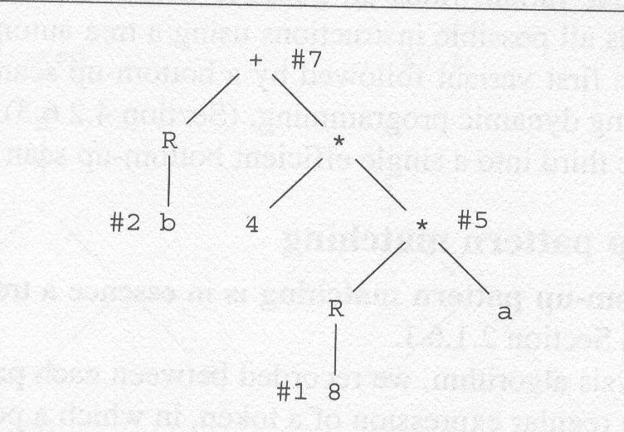
Bottom-up rewriting system (BURS) code generation (Cont.)
Top-down largest-fit rewrite (#7 chosen first)

Slide 69
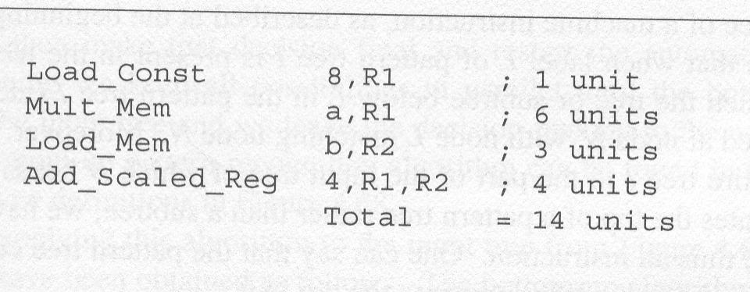
Bottom-up rewriting system (BURS) code generation (Cont.)
Code generated from the top-down largest-fit rewrite:

Slide 70
Register machine code vs. weighted register allocation
The assignment: a = a + b * 2
The AST:
=
a +
a *
b 2

Slide 71
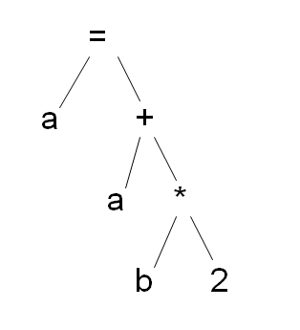
Register machine code vs. weighted register allocation (Cont.)
Register machine code:
Load_mem a, R1
Load_mem a, R2
Load_mem b, R3
Load_Const 2, R4
Multi_Reg R4, R3
Add_Reg R3, R2
Store_Reg R2, a
Use 4 registers.

Slide 72
Register machine code vs. weighted register allocation (Cont.)
Weighted register allocation code:
Load_mem b, R1
Load_Const 2, R2
Multi_Reg R2, R1
Load_mem a, R2
Add_Reg R2, R1
Store_Reg R1, a
Use 2 registers.

Slide 73
Homework
1. Given the grammar:
Start → Stmt $
Stmt → id assign E
| if lparen E rparen Stmt else Stmt fi
| begin Stmts end
Stmts → Stmts semi Stmt
| Stmt
E → E plus T
| T
T → id
| num
Show the AST for expression:
if (x + y) a = a + 2 else a = a + 7 fi

Slide 74
Homework 1 Solution
if
+ assign assign
x y a + a +
a 2 a 7

Slide 75
Homework
2. For the assignment: a = a + b * (2 + c)
And its AST:
=
a +
a *
b +
2 c
a). generate target code for register machine
b). generate target code using weighted register allocation

Slide 76
Homework Solution
a). Generate target code using register machine
Load_mem a, R1
Load_mem a, R2
Load_mem b, R3
Load_Const 2, R4
Load_mem c, R5
Add_Reg R5, R4
Multi_Reg R4, R3
Add_Reg R3, R2
Store_Reg R2, a

Slide 77
Homework Solution
b). Generate target code using weighted register allocation
Load_Const 2, R1
Load_mem c, R2
Add_Reg R2, R1
Load_mem b, R2
Multi_Reg R2, R1
Load_mem a, R2
Add_Reg R2, R1
Store_Reg R1, a

